Slide 1



TOPIC : Weather Forecasting Application (Using API)
Sreyas Institute of Engineering and Technology
An Autonomous Institution
Approved by AICTE, Affiliated to JNTUH
Accredited by NAAC-A Grade, NBA (CSE, ECE & ME) & ISO 9001:2015 Certified
DEPARTMENT OF ELECTRONICS & COMMUNICATION ENGINEERING
Object Oriented Programming Through Java Seminar
Class/Section : B.Tech , III Year - II semester , ECE – ‘A’
Academic Year : 2024-25
Presented by Batch : A-19
Nama Rahul - 22VE1A0439
Kanduri Srujan - 23VE5A0402
A.Nithin - 22VE1A0403
01-06-2025
Weather Forecasting Application (Using API)

Slide 2

Abstract
The Weather Forecasting Application utilizing APIs is designed to provide users with accurate and real-time weather information by integrating data from reliable sources like OpenWeatherMap. This application leverages modern web technologies to fetch and display current weather conditions, forecasts, and other meteorological parameters for any specified location. By harnessing the power of APIs, the system ensures timely updates and broad accessibility, making it a valuable tool for individuals and organizations alike. The application's user-friendly interface allows for seamless interaction, enabling users to make informed decisions based on the latest weather data. This project not only demonstrates the practical implementation of API integration but also highlights the significance of real-time data in enhancing daily life and operational efficiency across various sectors.
01-06-2025
Weather Forecasting Application (Using API)

Slide 3
Equipment
PC,
JAVA Software
OpenWeatherMap API key
01-06-2025
Weather Forecasting Application (Using API)

Slide 4
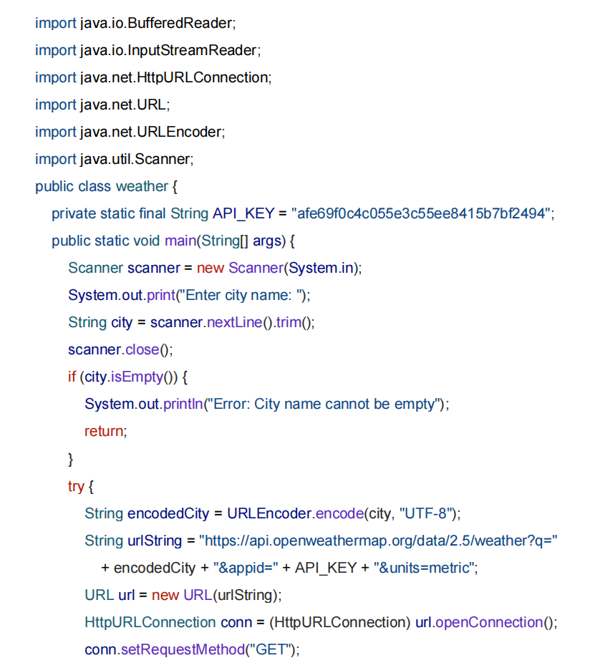
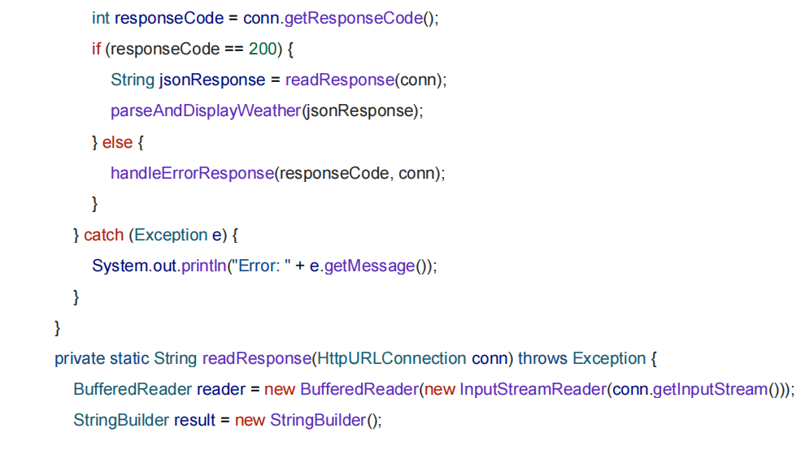
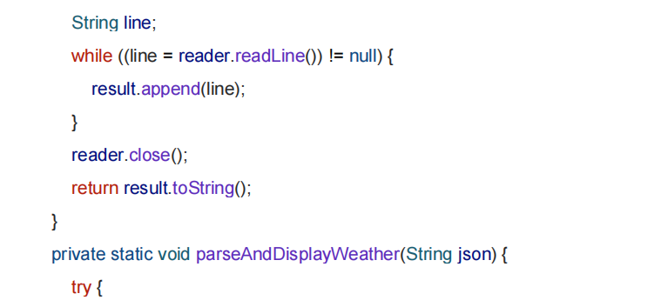
Program
01-06-2025
Weather Forecasting Application (Using API)

Slide 5
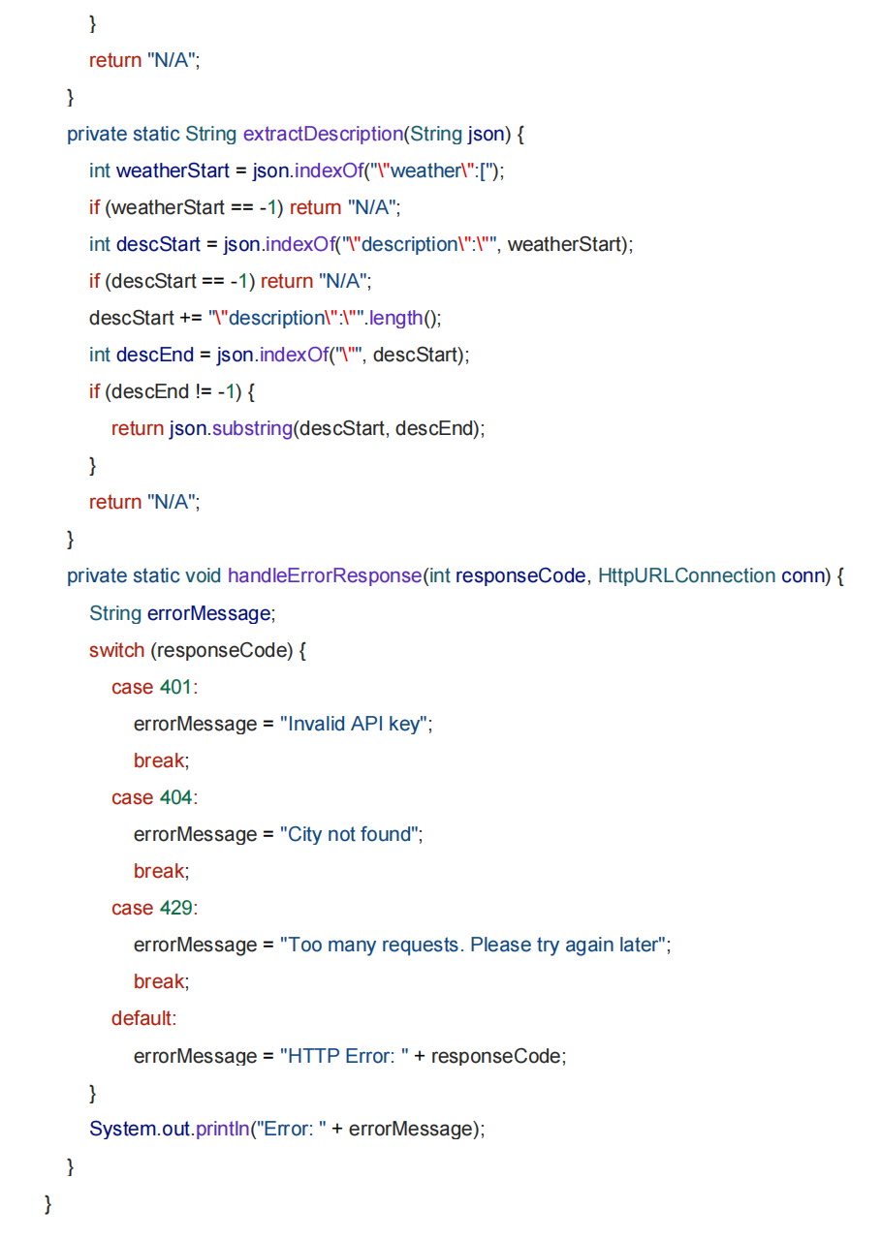
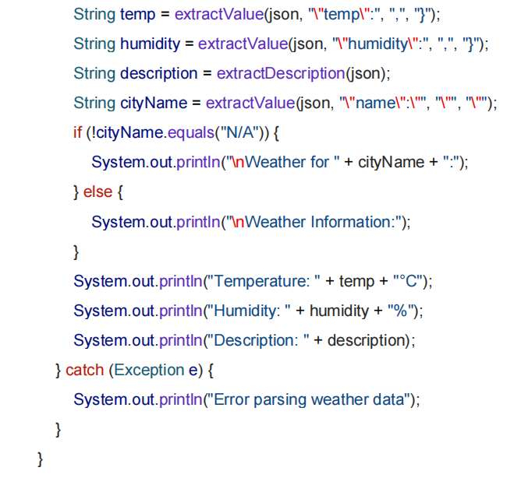
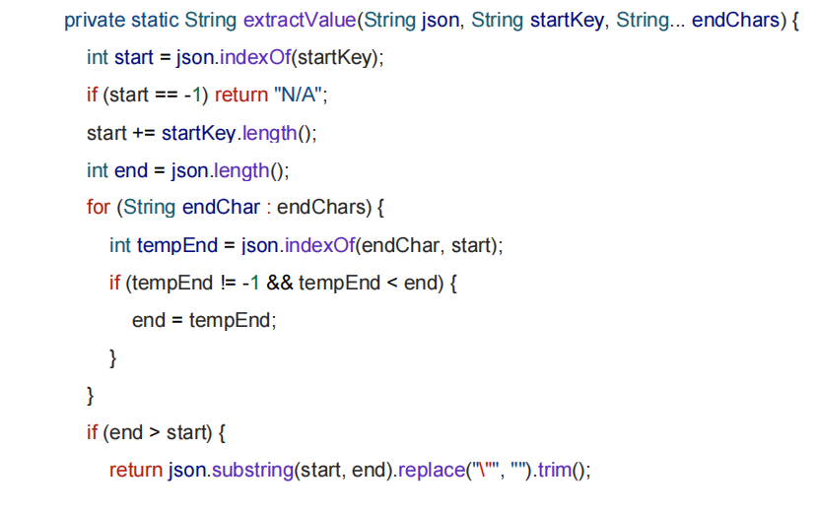
01-06-2025
Weather Forecasting Application (Using API)

Slide 6
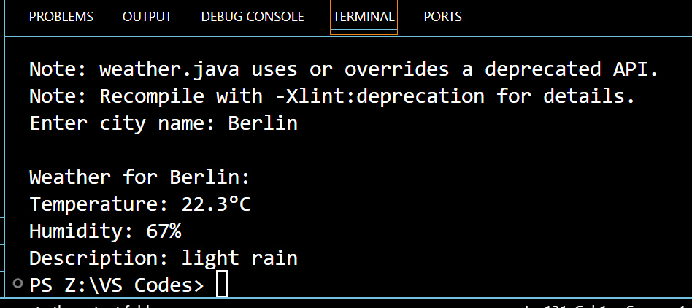
Simulation Results
01-06-2025
Weather Forecasting Application (Using API)

Slide 7
Parameters Evaluated
Primary Weather Parameters:
Temperature (current, minimum, maximum)
Humidity levels
Atmospheric pressure
Wind speed and direction
Precipitation levels
Cloud cover percentage
Derived Metrics:
Feels-like temperature
Weather condition descriptions (e.g., clear, cloudy, rain)
Sunrise and sunset times
01-06-2025
Weather Forecasting Application (Using API)

Slide 8
Advantages
Real-Time Data Access: Immediate retrieval of current weather conditions.
Accuracy: Enhanced forecasting precision through reliable API sources.
User Convenience: Accessible via web browsers without the need for installations.
Scalability: Easily extendable to include additional features or support more locations.
Cost-Effective: Utilizes free or affordable API services, reducing development costs.
01-06-2025
Weather Forecasting Application (Using API)

Slide 9
Applications
Agriculture: Assisting farmers in planning irrigation and harvesting schedules.
Travel and Transportation: Informing travelers and logistics companies about weather-related disruptions.
Event Planning: Helping organizers choose suitable dates and venues based on weather forecasts.
Disaster Management: Providing early warnings for severe weather conditions.
Healthcare: Advising vulnerable populations during extreme weather events.
01-06-2025
Weather Forecasting Application (Using API)

Slide 10
Conclusion
The application enhances decision-making by providing users with timely weather updates, enabling informed choices in activities like travel planning, agriculture, and event management. Its modular architecture ensures scalability and flexibility, allowing easy integration of additional features such as severe weather alerts, air quality indices, or IoT device connectivity. As a web-based solution, it offers cross-platform accessibility, making it convenient for users across various devices. Additionally, this project holds educational value by demonstrating the practical use of APIs and web development skills to address real-world challenges.
01-06-2025
Weather Forecasting Application (Using API)

Slide 11
Future Scope
Enhanced Features:
Incorporation of machine learning algorithms for predictive analytics.
Development of mobile application versions for broader accessibility.
Integration with IoT devices for localized weather monitoring.
Expanded Data Sources:
Utilizing multiple APIs to cross-verify and enrich weather data.
Incorporating satellite imagery for visual weather representations.
01-06-2025
Weather Forecasting Application (Using API)

Slide 12
References
Suraj Singh et al., "Weather Forecasting Using API: A Comparative Study," IRJMETS, May 2023.
Sathyabama Institute of Science and Technology, "Weather Forecasting System," 2022.
GeeksforGeeks, "Forecast Weather Project," 2023.
OpenWeatherMap API Documentation.
Wikipedia, "Weather Forecasting."
01-06-2025
Weather Forecasting Application (Using API)

